Slide 1



HR Analytics Dashboard
View in Power BI
Last data refresh:
26/07/2023 13:32:35 UTC
Downloaded at:
26/07/2023 14:14:04 UTC

Slide 2
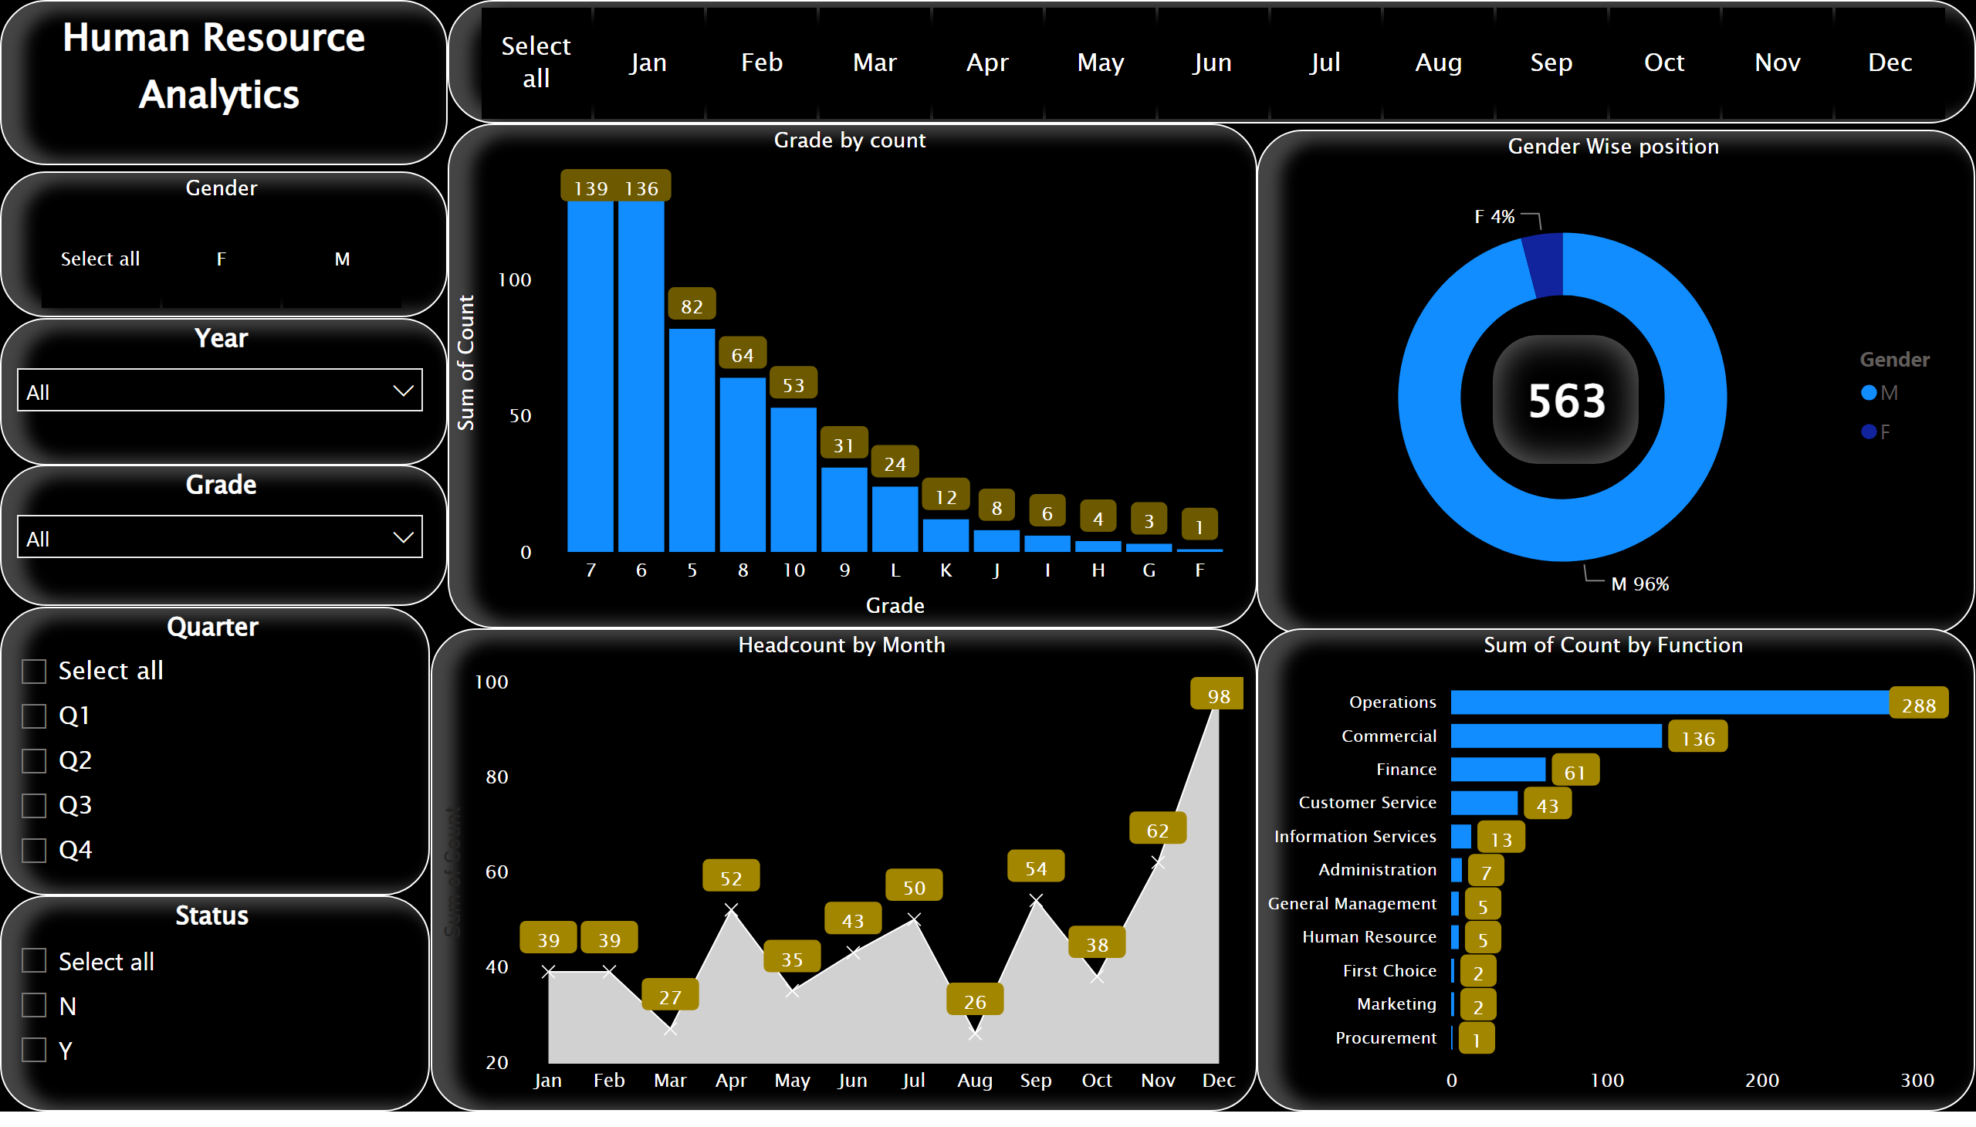
Notes:
slicer
No alt text provided
HR
No alt text provided
Gender Wise position
No alt text provided
card
No alt text provided
Grade by count
No alt text provided
Headcount by Month
No alt text provided
clusteredBarChart
No alt text provided
Gender
No alt text provided
Year
No alt text provided
Grade
No alt text provided
Quarter
No alt text provided
Status
No alt text provided

